Slide 1
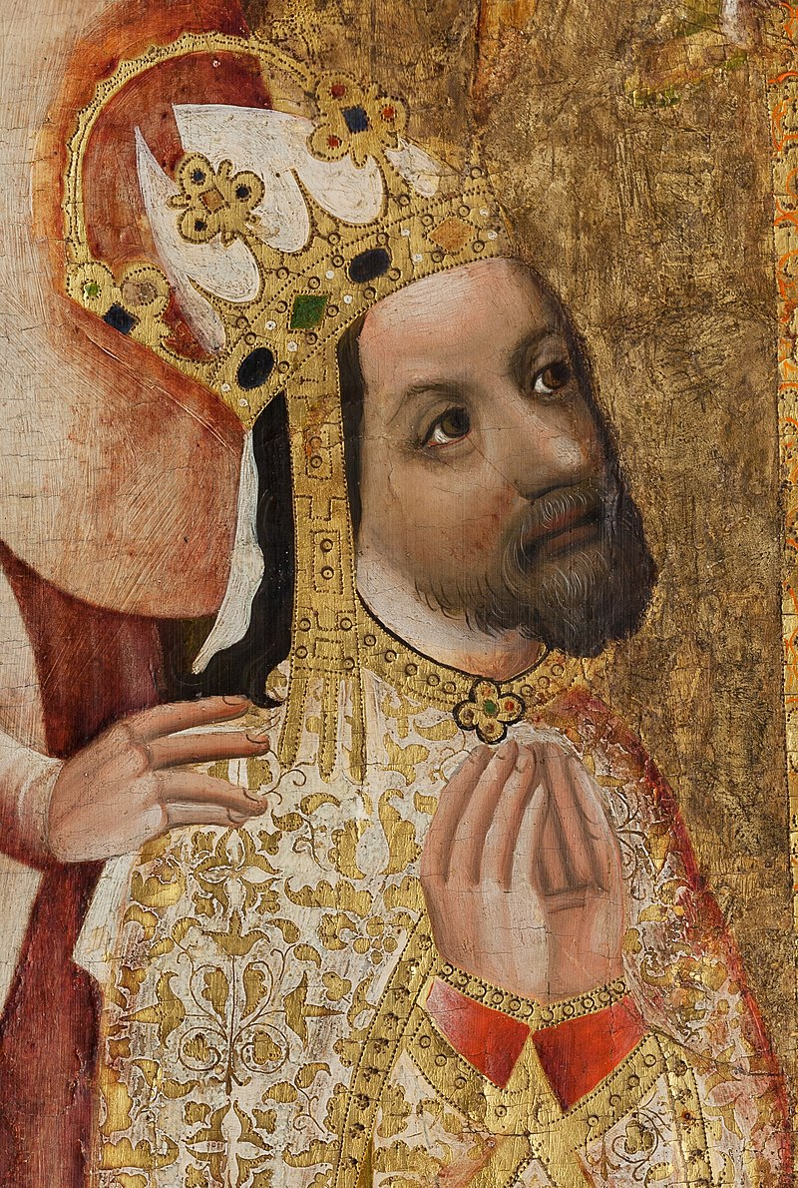
Notes:
By Anonymous 15th century painter - Le Livre des conquêtes et faits d’Alexandre, Paris, musée du Petit-Palais, folio 86 recto, Public Domain, https://commons.wikimedia.org/w/index.php?curid=24834963
By Circle of Theodoric of Prague - 1./2. Self-scanned from: Bohemian art of the gothic and early renaissance periods, Press Foto, Olomouc3. detail from: File:Anonym - Votive Painting of Archbishop Jan Očko of Vlašim.jpg, Public Domain, https://commons.wikimedia.org/w/index.php?curid=1755205

Slide 2
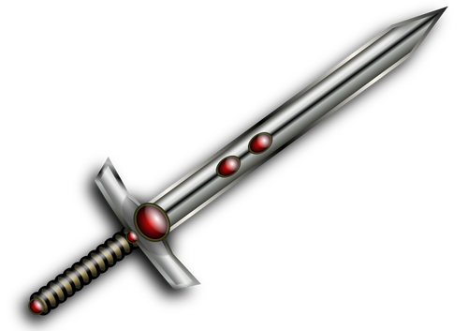
Notes:
Autor: Neznámý – Landeshauptarchiv Koblenz, Volné dílo, https://commons.wikimedia.org/w/index.php?curid=342700

Slide 7
Notes:
By K. Pacovsky - Own work, CC BY-SA 4.0, https://commons.wikimedia.org/w/index.php?curid=48912958
By Ancient_warded_lock_key.jpg: Pethrusderivative work: Adiblol (talk) - Ancient_warded_lock_key.jpg, CC BY-SA 3.0, https://commons.wikimedia.org/w/index.php?curid=7787149

